Slide 1
Outline
Introduction
CMOS devices
CMOS technology
CMOS logic structures
CMOS sequential circuits
CMOS regular structures

Slide 2
CMOS logic structures
CMOS logic: “0” and “1”
The MOST - a simple switch
The CMOS inverter
The CMOS pass gate
Simple CMOS gates
Complex CMOS gates

Slide 3
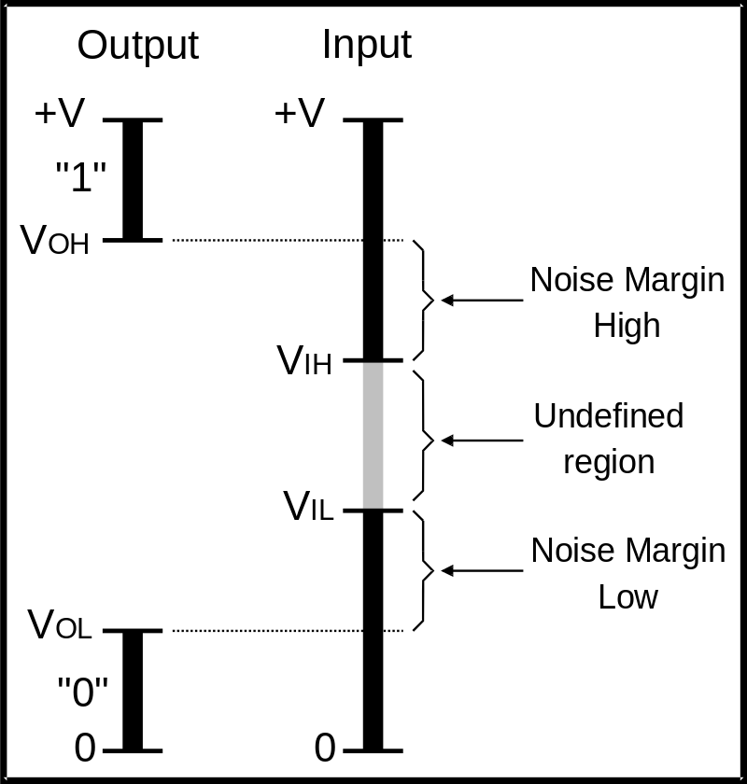
CMOS logic: “0” and “1”
Logic circuits process Boolean variables
Logic values are associated with voltage levels:
  V_{IN} > V_{IH} ⇒ “0”
  V_{IN} < V_{IL} ⇒ “0”
Noise margin:
  NM_{H}=V_{OH}-V_{IH}
  NM_{L}=V_{IL}-V_{OL}

Slide 4
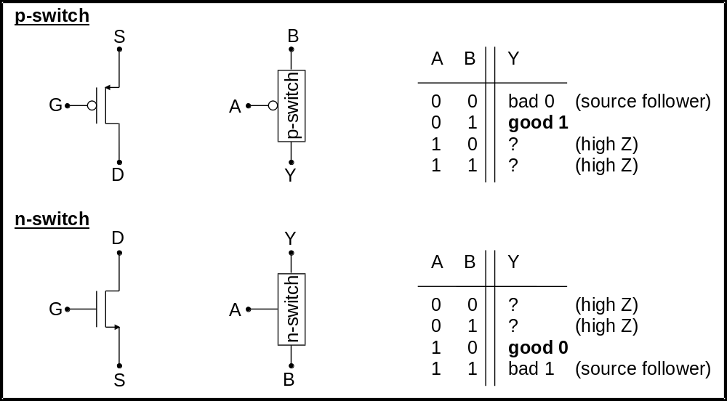
The MOST - a simple switch

Slide 5
MOSFET’s in digital design
Important characteristics:
  It is an unipolar device
    NMOS - charge carrier: electrons
    PMOS - charge carrier: holes
  It is a symmetrical device
    Source = drain
  High input impedance (Ig=0)
    Low standby current in CMOS configuration
  Voltage controlled device with high fan-out

Slide 6
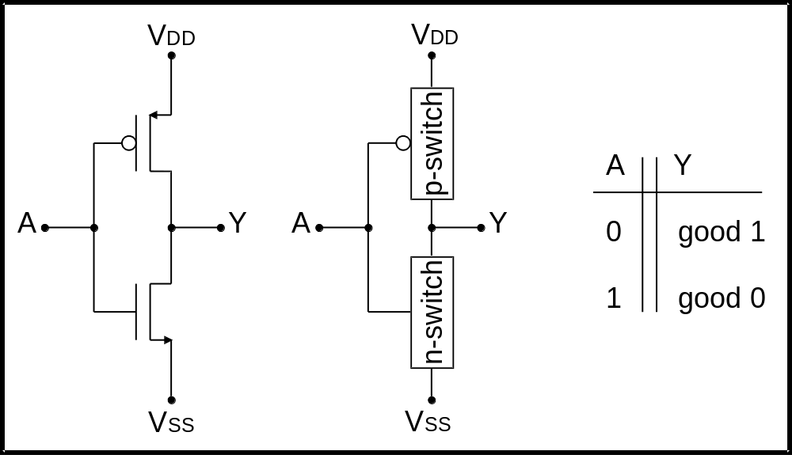
The CMOS inverter

Slide 7
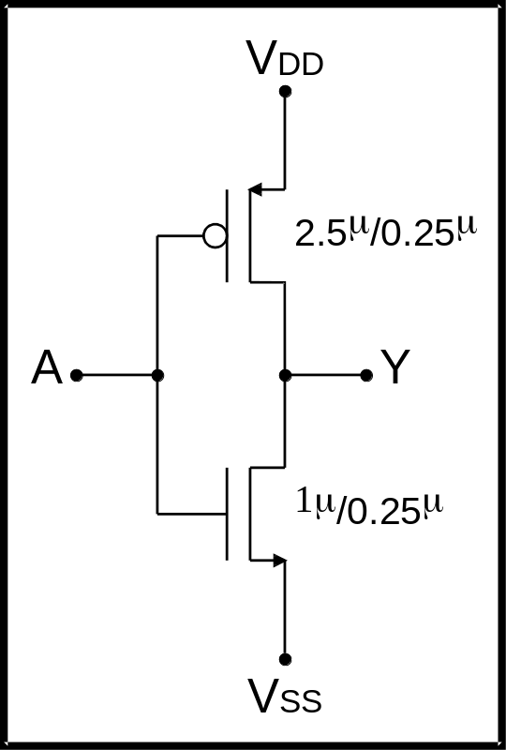
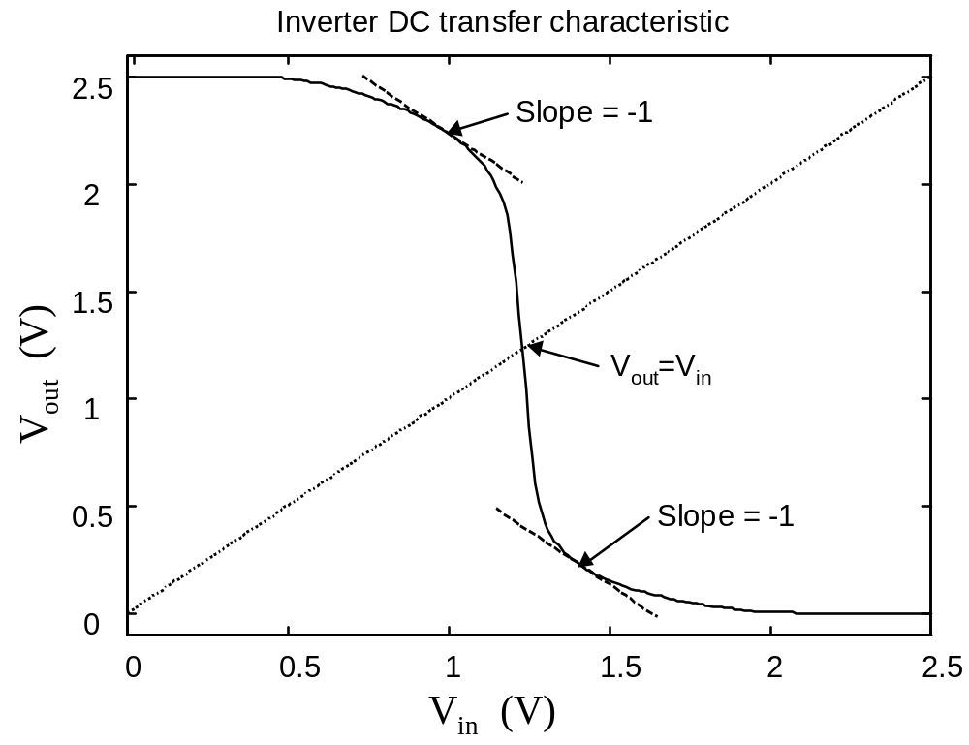
The CMOS inverter

Slide 8
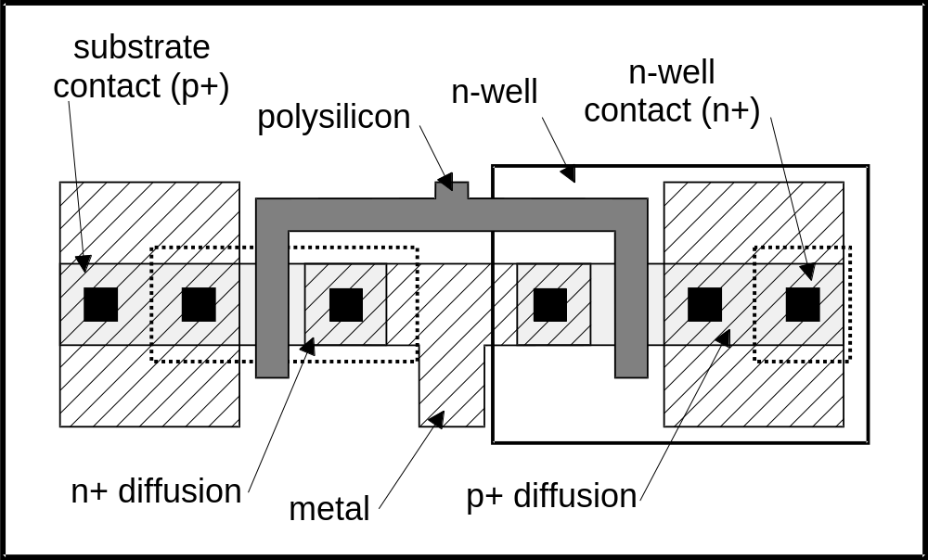
The CMOS inverter

Slide 9
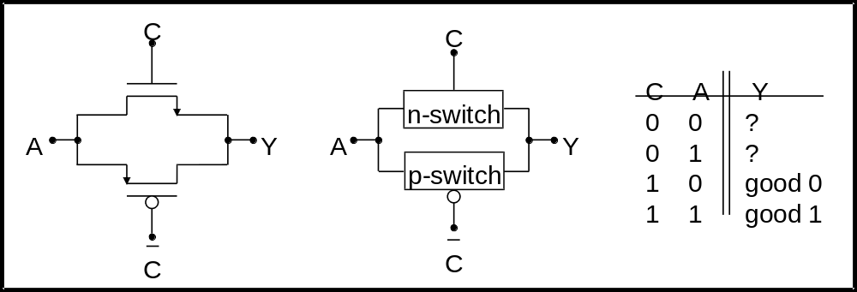
The CMOS pass gate

Slide 10
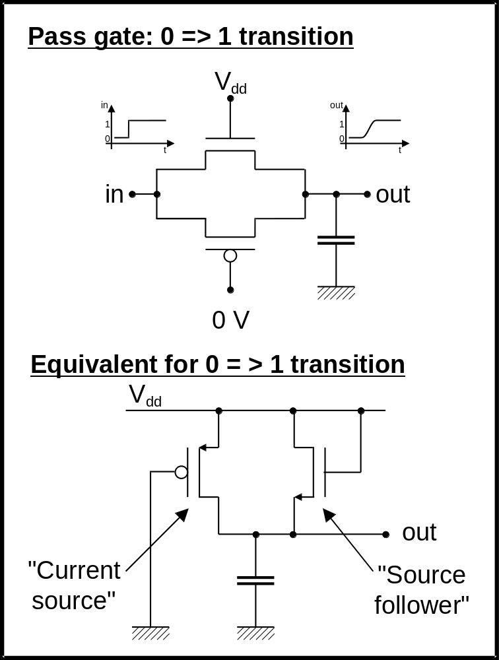
The CMOS pass gate
Regions of operation:
“0” to “1” transition
NMOS:
  source follower
  V_{gs} = V_{ds} always:
    V_{out} < V_{dd}-V_{TN} ⇒ saturation
    V_{out} > V_{dd}-V_{TN} ⇒ cutoff
  V_{TN} > V_{TN0} (bulk effect)
PMOS:
  current source
  V_{out} < |V_{TP}| ⇒ saturation
  V_{out} > V_{TP} ⇒ linear

Slide 11
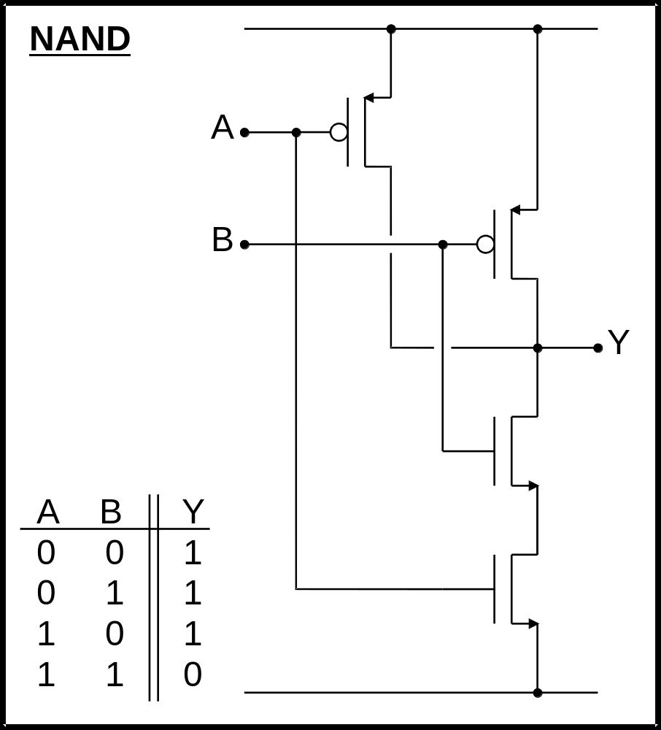
Simple CMOS gates

Slide 12
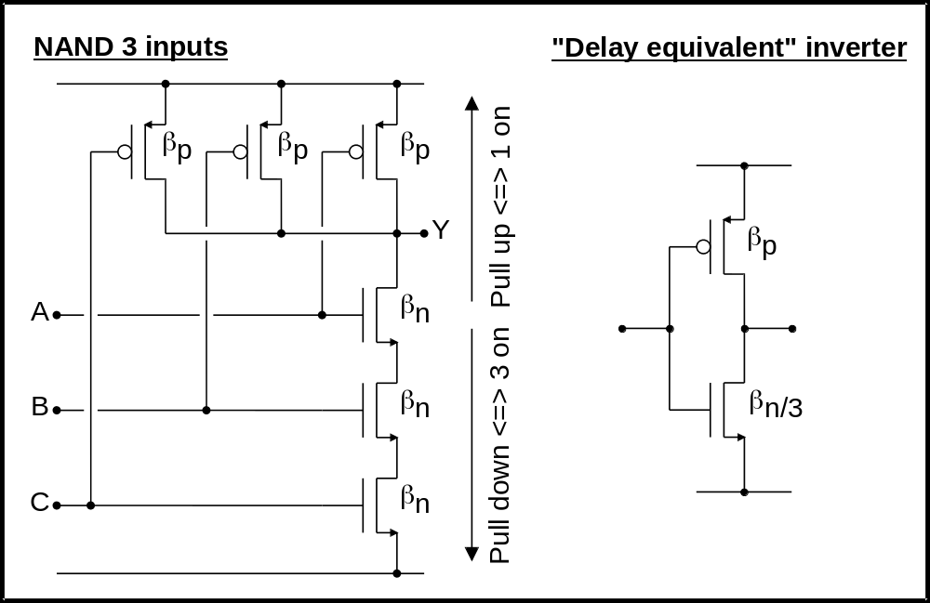
Simple CMOS gates

Slide 13
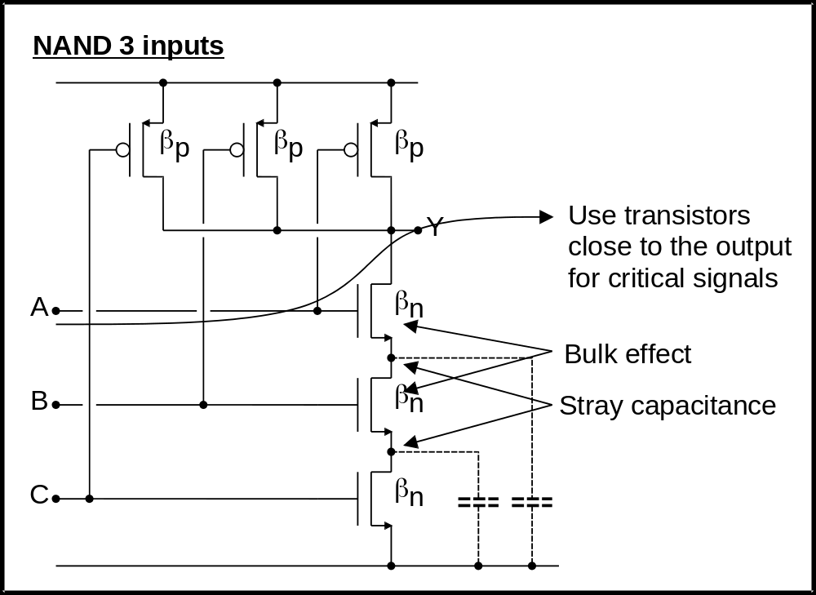
Simple CMOS gates

Slide 14
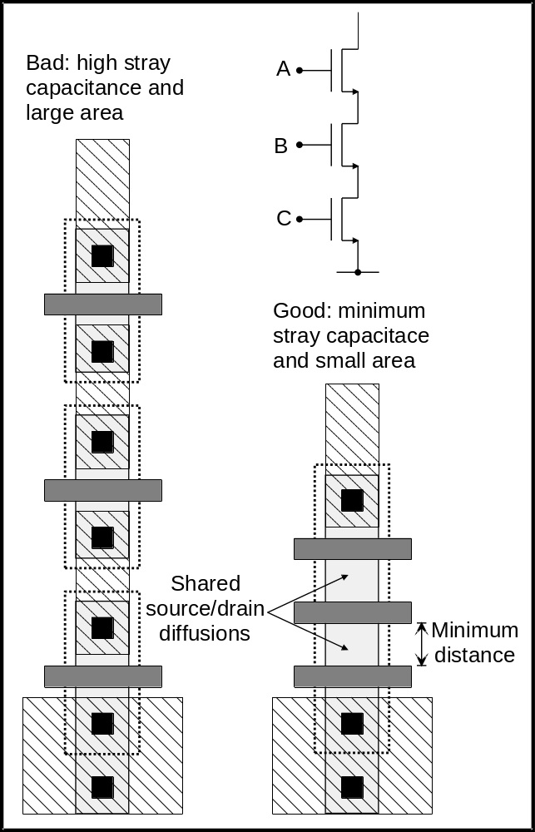
Simple CMOS gates

Slide 15
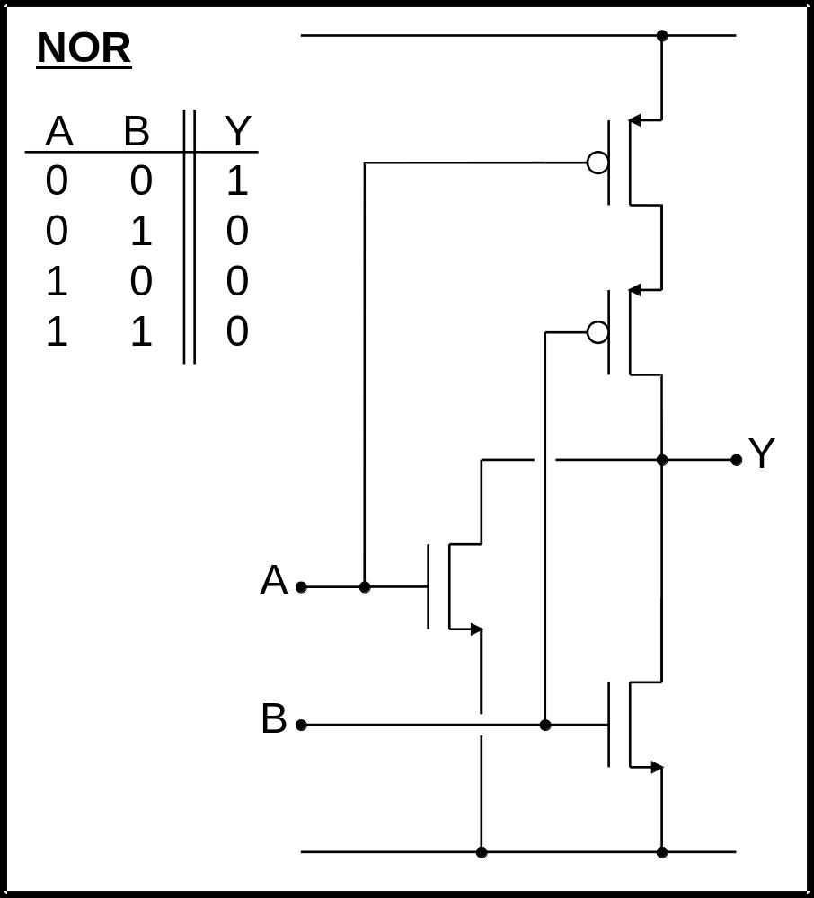
Simple CMOS gates

Slide 16
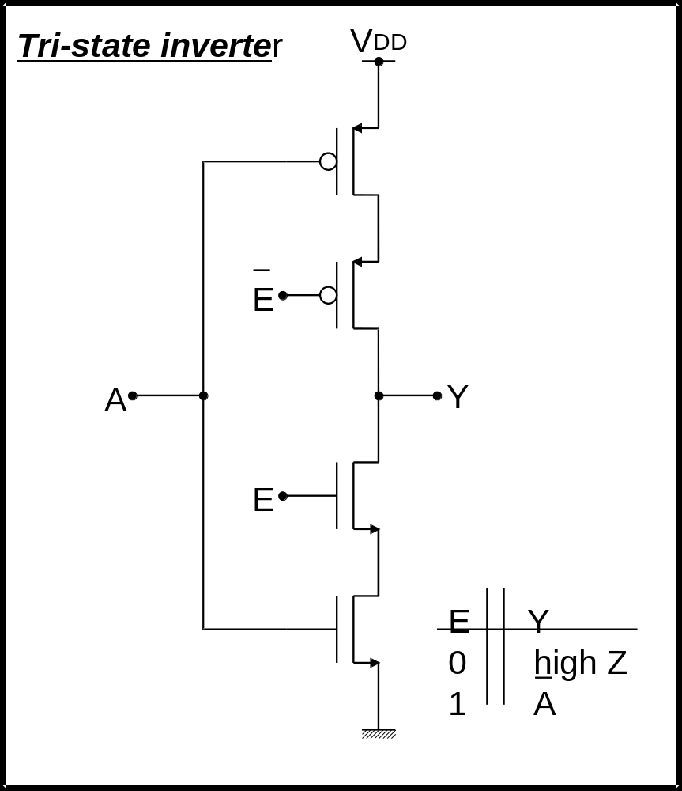
Simple CMOS gates

Slide 17
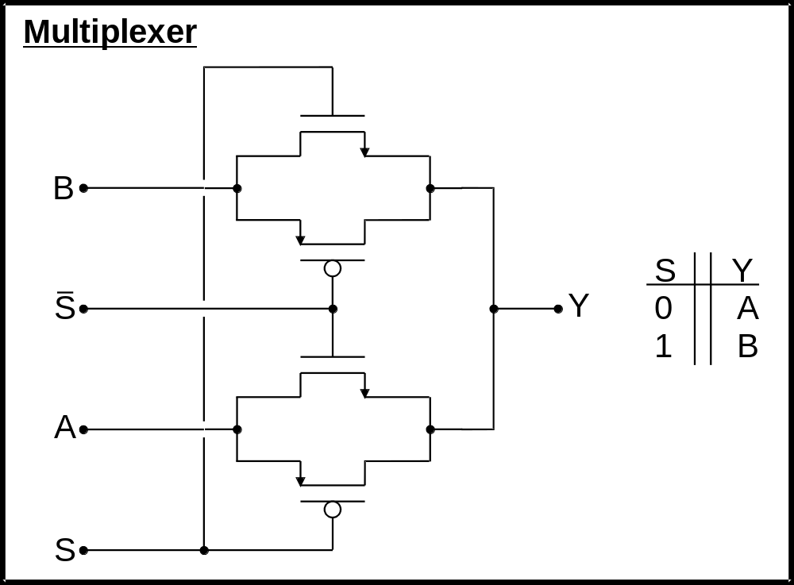
Complex CMOS gates

Slide 18
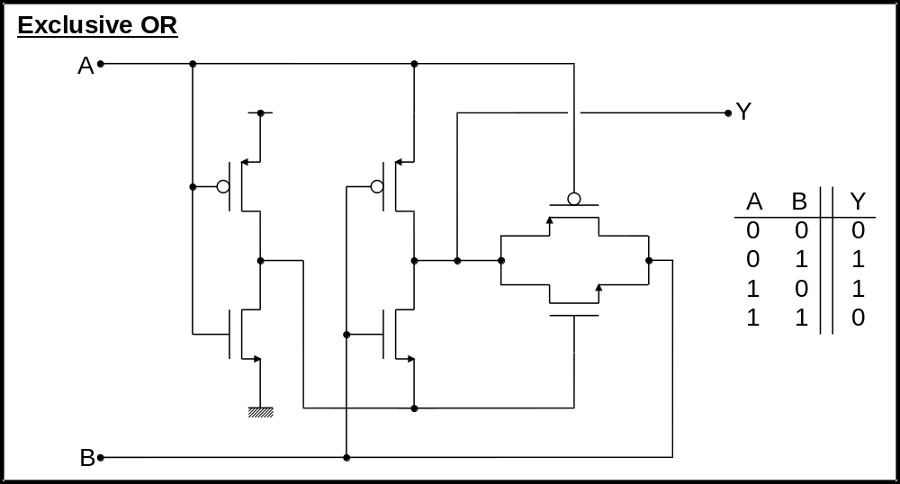
Complex CMOS gates

Slide 19
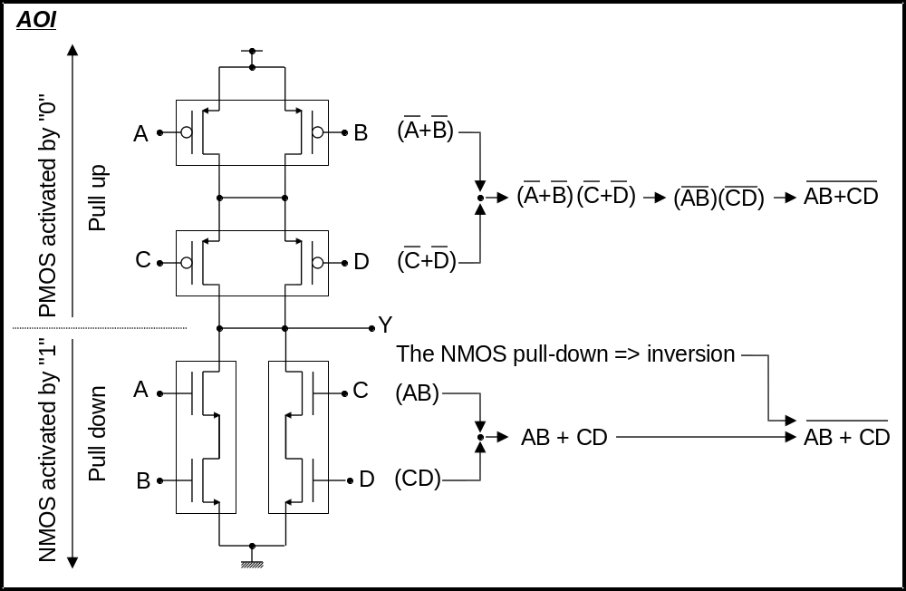
Complex CMOS gates

Slide 20
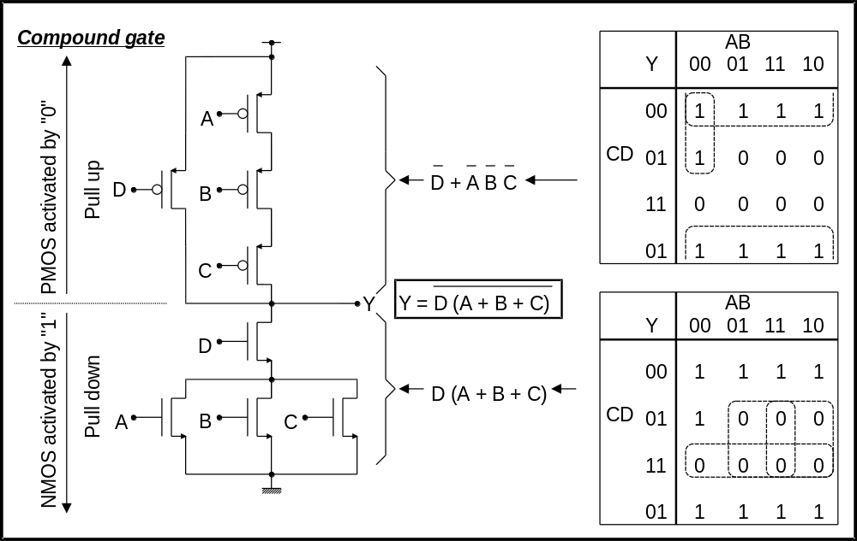
Complex CMOS gates

Slide 21
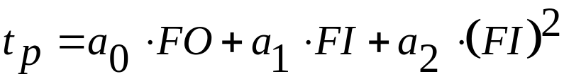
Complex CMOS gates
Can a compound gate be arbitrarily complex?
  NO, propagation delay is a strong function of fan-in:
  FO ⇒ Fan-out, number of loads connected to the gate:
    2 gate capacitances per FO + interconnect
  FI ⇒ Fan-in, Number of inputs in the gate:
    Quadratic dependency on FI due to:
      Resistance increase
      Capacitance increase
  Avoid large FI gates (Typically FI ≤ 4)

Slide 22
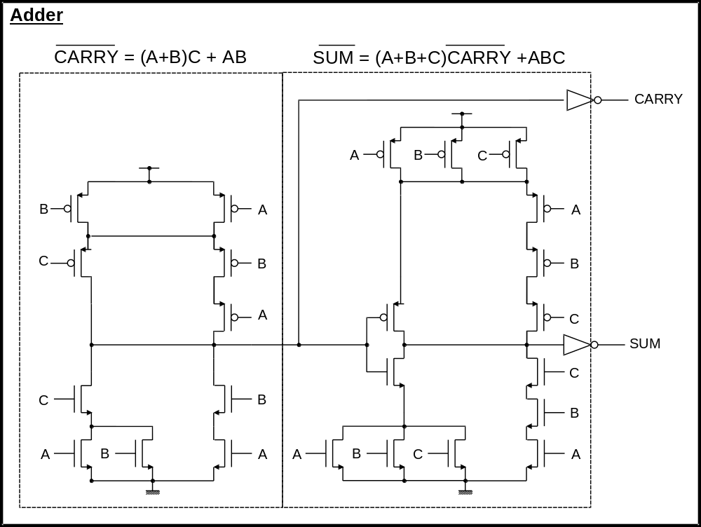
Complex CMOS gates

